Slide 1

Commodity Finance Model: Gold
By: Viral Jani, Hariom Vyas, Krutal Patel, Durga Verma
Guided By: Dr. Antonio Diana

Slide 2


Introduction
Overview of the domain and the project

Slide 3

Commodity: Gold
Although gold is important to industry and the arts, it also retains a unique status among all commodities as a long-term store of value.
In the past, gold had been used as currency in several countries, including the USA. To ensure the repayment of foreign loans and to limit inflation, which has the effect of revealing a country's financial strength, precious metals like gold are now kept by the central banks of all nations.
For several factors, gold prices might change daily. This problem is influenced by a few variables, including the production and supply management chain, the cost of material, and the location

Slide 4

Project Overview
In this project, we would use the most complete collection of characteristics to estimate gold rates. We would also use a variety of machine learning methods and compare the outcomes. We also pinpoint the characteristics that have a significant impact on gold rates.
For this project, we will forecast the gold price based on several factors and changes in prices of other commodities like Crude oil, Silver, Platinum, Palladium, Rhodium, USD Index, and many more.
We also leveraged several Machine learning ensemble models after performing feature selection and feature engineering to figure out the best model.

Slide 5
Project
Overview of the data, methodology and the business model

Slide 6
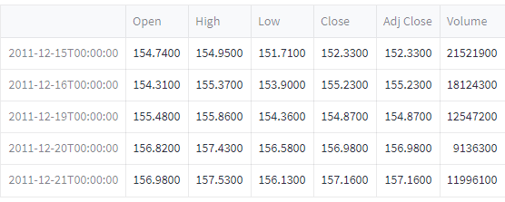
Data Overview
Data for this study is collected from November 18th, 2011, to January 1st, 2019, from various sources. The data has 1718 rows in total and 80 columns in total. Data for attributes, such as Oil Price, Standard and Poor’s (S&P) 500 index, Dow Jones Index US Bond rates (10 years), Euro USD exchange rates, prices of precious metals Silver and Platinum and other metals such as Palladium and Rhodium, prices of US Dollar Index, Eldorado Gold Corporation and Gold Miners ETF were engineered or gathered from Yahoo Finance.
Features
Preview
For the above-mentioned attributes, there is data like Date, Open, High, Low, Close, Adjusted Close, and Volume which was collected from Yahoo finance.
The target variable is the Adjusted close value of the Gold.

Slide 7

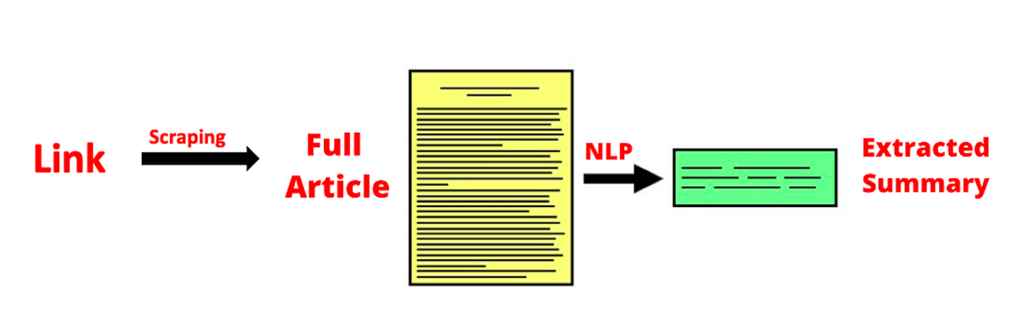
Data Overview (CONT.)
For Sentiment analysis, we gathered news from various online sources like Google, Guardian which contains the information on the most recent trends regarding gold.
Data Collection
For data collection, we used packages like newscatcher, pygoolenews to search through websites like Guardian and Google to get any data regarding top news about Gold.
We also leveraged BeautifulSoup to crawl through websites where API or other resources are not available to retrieve the data.

Slide 8
Methodology
Data Extraction
Findings/Insights
Data Cleaning and Transformation
Model Training
Feature Selection and Feature Engineering

Slide 9
Findings
Overview of the findings/results of the business models and what insights they convey

Slide 10
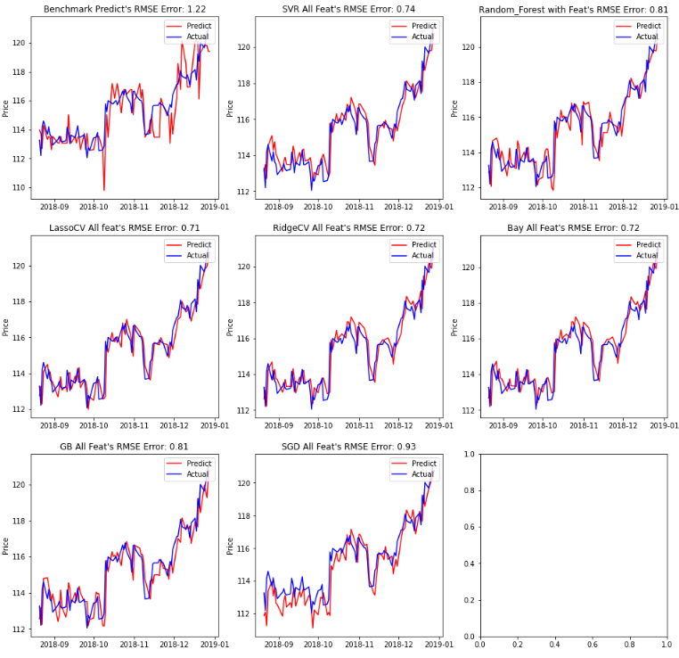
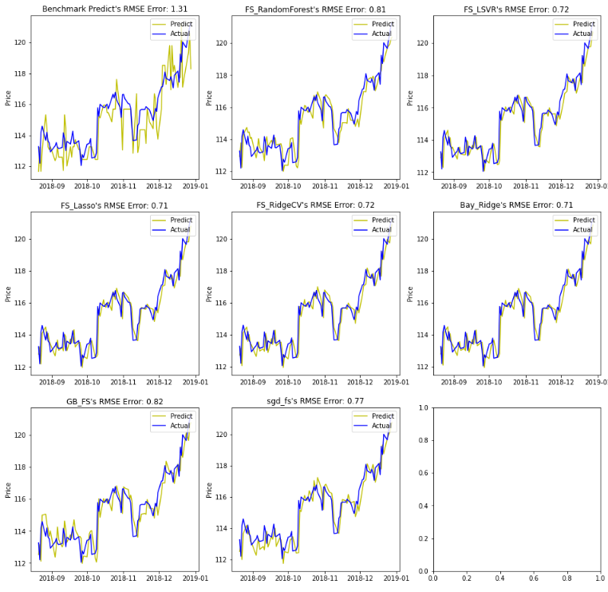
Machine learning Models
Comparing the accuracy of all the models before and after the feature selection and feature engineering.

Slide 11
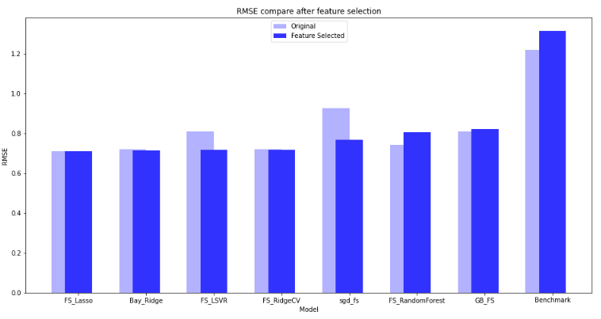
Machine learning Models (CONT.)
Comparing the models before and after feature selection and feature engineering.

Slide 12
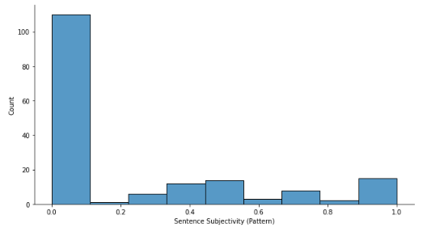
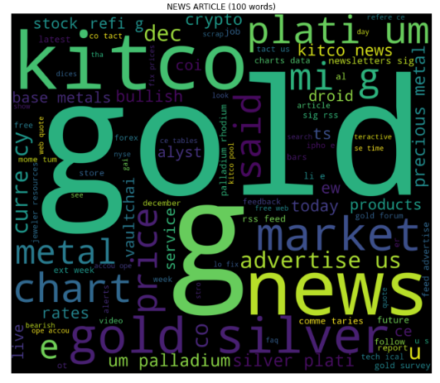
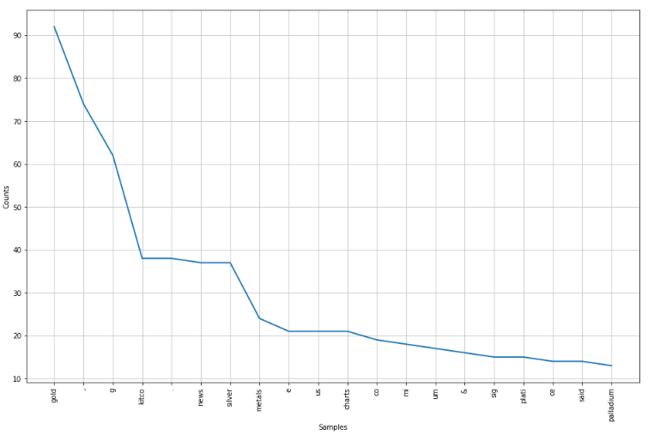
News Analysis
News analysis of the news data.

Slide 13
Business Utility And Future Prospects
How it would be useful to the clients and what could be the possible future improvements that can be implemented

Slide 14
How would the insights be helpful to the clients
Now that we have found insights, let’s see how they would be helpful to potential clients.
But who could be our potential client? – Investors, Banks, Electronics sector, Jewelry Market, Gold Sellers
Banks, Investors and Jewelry Market
Electronics Sector
Gold plays an important part in global central bank reserves, and they are significant holders of gold.
Emerging market central banks have increased their official gold purchasing
Investors of all sorts are coming to accept gold as a reliable, tangible long-term store of value that has moved independently of other assets.
India and China are by far the largest jewelry markets, together accounting for over 50% of the global total.
Gold is used as an industrial metal in a broad range of applications, but demand is driven by the electronics sector which accounts for ~80% of gold used in technology.
The trend of electrification is providing support for gold demand in the sector, with most types of semiconductor chips using the metal either as a coating, or in the form of thin bonding wires.

Slide 15

What would be future developments
After providing insights for Gold, what more could we give to our clients?
We can use the same methodology on other commodities, like precious metals, petroleum, agriculture, and much more.
We can also create a dashboard for the users to use which will display the data of the commodity that they need.
A product can also be launched with a smart AI recommendation system which would suggest the customers when would it be best to buy certain commodities.
This Photo by Unknown Author is licensed under CC BY-SA

Slide 16

About Us
Our Team:
  Viral Harishkumar Jani
  Hariom Vyas
  Krutal Patel
  Durga Siva Sai Verma Rudraraju

Slide 17

Thank You
Viral Harishkumar Jani
Hariom Vyas
Krutal Patel
Durga Siva Sai Verma Rudraraju

